Slide 1
ACUTE GASTROENTERITIS IN CHILDREN By Dr.Mahadevi A.L Assistant Professor Dept of Paediatrics Date-19-07-2021

Slide 2
Gastroenteritis is inflammation of the digestive tract that results in vomiting, diarrhea, or both and is sometimes accompanied by fever or abdominal cramps.

Slide 3
Gastroenteritis, sometimes incorrectly called “stomach flu,” is the most common digestive disorder among children.
Severe gastroenteritis causes dehydration and an imbalance of blood chemicals (electrolytes) because of a loss of body fluids in the vomit and stool.

Slide 4
Gastroenteritis is usually caused by a viral, bacterial, or parasitic infection.
The infection causes a combination of vomiting, diarrhea, abdominal cramps, fever, and poor appetite, which can lead to dehydration.
The child’s symptoms and history of exposure help to confirm the diagnosis.
Gastroenteritis is best prevented by encouraging children and their caretakers to wash their hands and teaching them to avoid improperly stored foods and contaminated water.
Fluids and rehydrating solutions are given, but sometimes children need to see a doctor, and even to be hospitalized.

Slide 5
EPIDEMIOLOGY
About 3 to 5 billion episodes occur worldwide each year, most commonly in developing countries among children under 5 years of age.
In developing countries where children are more vulnerable and care is often not easy to access, about 1.5 to 2.5 million children die each year from diarrhea and dehydration caused by gastroenteritis.
In developed countries where children are well nourished and have access to excellent medical care (most importantly, hydrating fluids given by vein [intravenously] when needed), the consequences are not as severe.
However, acute gastroenteritis is still a frequent problem in the United States.
Each year, gastroenteritis is responsible for about 1.5 million doctor visits, 200,000 hospital admissions, and 100 to 300 deaths.

Slide 6
Causes of Gastroenteritis
Most gastroenteritis is caused by
Viruses (most common cause)
Bacteria
Parasites
Rarer causes of gastroenteritis include
Chemical toxins
Drugs
Rarely, gastroenteritis is the result of an allergic condition (eosinophilic gastroenteritis) or a food allergy .

Slide 7
Viruses
Viruses are the most common cause of gastroenteritis in the United States.
The viruses that most commonly cause gastroenteritis are
Norovirus (most common in the United States)
Rotavirus (most common worldwide)
Astrovirus
Adenovirus
Children usually contract viral gastroenteritis from other children who have had it or who have been exposed to it, such as those in child care centers, schools, and other crowded settings.
Viral gastroenteritis is very contagious and spreads particularly easily from child to child.

Slide 8
Fecal-oral transmission is the usual way that viral gastroenteritis spreads’
Fecal-oral means that viruses in the diarrhea stool (feces) from an infected person are taken into the mouth of another person.
Of course, people do not ingest stool directly.
Instead, children with diarrhea and/or their caretakers may have some infected stool on their hands (particularly when they do not thoroughly wash their hands).
Then any objects they touch (such as a diaper, a toy, or food) also become contaminated with infected stool.
Other children who touch that object and then put their hands and fingers in and near their mouth may get infected by the virus.
Viral gastroenteritis can also be spread by sneezing and spitting.

Slide 9
Norovirus has become the most common cause of gastroenteritis among young children in the United States since the introduction of rotavirus vaccines.
Infections occur year-round, but 80% occur from November to April.
Most people are infected after swallowing contaminated food or water.
Because norovirus is highly contagious, infection can easily be spread from person to person.
Rotavirus is the most common cause of severe, dehydrating diarrhea among infants and children worldwide.
The frequency has decreased since the introduction of rotavirus vaccines .
It usually affects infants and toddlers.
Rotavirus is highly contagious.
Most infections are spread by fecal-oral transmission.
Infected infants may spread the infection to adults.
In temperate climates, rotavirus infections are most common in the winter months and are less common in the summer.
In tropical climates, they can occur year-round.

Slide 10
Astrovirus can infect people of all ages but usually infects infants and young children.
Infection is most common in the winter and is spread by fecal-oral transmission.
Adenovirus most commonly affects children under the age of 2.
Infections occur year-round and increase slightly in the summer.
The infection is spread by fecal-oral transmission.

Slide 11
Bacteria
The bacteria that most commonly cause gastroenteritis include
Escherichia coli (E. coli)
Salmonella
Campylobacter
Shigella
Yersinia
Clostridium difficile

Slide 12
Children can contract bacterial gastroenteritis by
Touching or eating contaminated foods, particularly raw or inadequately cooked meats or eggs
Eating contaminated shellfish
Drinking unpasteurized milk or juice
Touching animals that carry certain bacteria
Swallowing contaminated water, such as from wells, streams, and swimming pools
Bacteria may grow in many types of foods that have been left out and not refrigerated (potential problem situations include buffets and picnics).
Staphylococcus bacteria in contaminated food may secrete a toxin that causes sudden vomiting and diarrhea.
Gastroenteritis contracted from food containing microorganisms or bacterial toxins is sometimes called food poisoning .

Slide 13
Children can contract Salmonella by contact with reptiles (turtles or lizards), birds, or amphibians (frogs or salamanders) and rarely can contract
E. coli by contact with animals at petting zoos. Occasionally, some bacteria are transmitted by dogs or cats with diarrhea.
Children can contract gastroenteritis by swallowing or swimming in contaminated water, such as from wells, streams, water parks, and swimming pools (called recreational water illness ).
Infection with the bacteria Clostridium difficile may occur in children who have taken antibiotics or who have finished a course of antibiotics in the last 6 to 10 weeks (see Clostridioides (formerly Clostridium) difficile -Induced Colitis).
Some children may develop Clostridium difficile infection after being in the hospital.

Slide 14
Parasites
Gastroenteritis caused by parasites (such as Giardia intestinalis and Cryptosporidium parvum ) is usually acquired by drinking contaminated water or by fecal-oral transmission (which is known to occur in day care centers).
The parasite Entamoeba histolytica is a common cause of bloody diarrhea in developing countries but is rare in the United States.
Chemical toxins
Gastroenteritis may result from ingesting chemical toxins .
These toxins can be found in plants, such as poisonous mushrooms, or in certain kinds of exotic seafood .
Children who eat these substances may develop gastroenteritis.
Children also can develop gastroenteritis after drinking water or eating food that is contaminated by chemicals such as arsenic, lead , mercury, or cadmium.
Drugs
Many drugs cause diarrhea.
Children who are given (or who accidentally ingest) certain drugs (such as antibiotics or antacids) may develop gastroenteritis

Slide 18
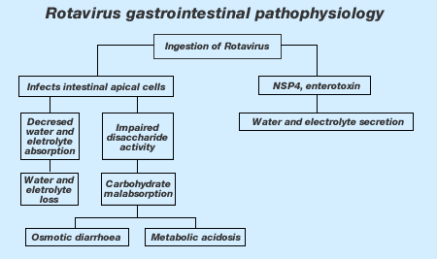

Slide 21
Symptoms of Gastroenteritis
Symptoms of gastroenteritis are usually a combination of
Vomiting
Diarrhea
Abdominal cramps
Fever
Poor appetite
The most common symptoms of gastroenteritis, regardless of cause, are vomiting and diarrhea.
Gastroenteritis resulting from an infection can also cause fever. Abdominal pain is also common.

Slide 22
Gastroenteritis caused by viruses
Viruses cause watery diarrhea. Stools rarely contain mucus or blood.
Rotavirus may last 5 to 7 days in infants and young children. Vomiting occurs in most children, and some have fever.
Norovirus causes more vomiting than diarrhea and lasts only 1 to 3 days.
Adenovirus causes mild vomiting 1 to 2 days after diarrhea starts. The diarrhea can last 1 to 2 weeks.
Astrovirus symptoms are similar to a mild rotavirus infection.

Slide 23
Gastroenteritis caused by bacteria
Bacteria are likely to cause fever and may cause bloody diarrhea.
Gastroenteritis caused by parasites
Parasites typically cause diarrhea that may last for a long time and may cause diarrhea that comes and goes.
The diarrhea is usually not bloody.
Children may be very tired and lose weight when they have long-lasting diarrhea caused by a parasitic infection.

Slide 25
Danger signs of dehydration in infants that require immediate medical care include the following:
The soft spot on the head is sunken.
The eyes are sunken.
There are no tears when they cry.
The mouth is dry.
They are not producing much urine.
They have reduced alertness and energy (lethargy).
However, it can be hard to tell how much urine diapered children who are having frequent watery stools are producing.
It is easier to identify a decrease in the passage of urine and excessive thirst in older children.

Slide 26
Diagnosis of Gastroenteritis
Symptoms, the child's history, and a physical examination
Sometimes tests on stool
The diagnosis of gastroenteritis is usually obvious from the symptoms alone, but the cause often is not.
Sometimes other family members have recently been ill with similar symptoms.
Other times, gastroenteritis can be traced to contaminated water or inadequately cooked, spoiled, or contaminated food, such as raw seafood or mayonnaise left out of the refrigerator too long.
Recent travel, especially to certain foreign countries, and recent antibiotic use may give doctors clues to the cause as well.
Diagnostic tests are not usually needed because most forms of gastroenteritis last a short time.
However, if the symptoms are severe or last for more than 48 hours, stool samples may be examined in a laboratory for white blood cells and bacteria, viruses, or parasites.
Blood tests may be done as well to look for signs of complications.

Slide 28
Prevention of Gastroenteritis
Two vaccines to prevent rotavirus infection are available as part of the recommended infant vaccination schedule .
The current rotavirus vaccines are not associated with intussusception (a serious intestinal problem), as was the case with the original vaccine.
The rotavirus vaccines have decreased rotavirus infections by 60 to 90%.
Children who are old enough should be taught to wash their hands and to avoid improperly stored foods and contaminated water.
A good general guideline is to keep cold foods cold and hot foods hot.
Food placed out for consumption should be consumed within an hour.

Slide 29
Breastfeeding is another simple and effective way to help prevent gastroenteritis in infants.
Breastfed infants have significantly lower rates of gastroenteritis compared to formula-fed infants.
For infants who are bottle-fed, caregivers should wash their hands thoroughly with soap and water before preparing bottles.
Caregivers should also wash their hands thoroughly after changing diapers.
Diaper-changing areas should be regularly disinfected with a freshly prepared solution of household bleach (¼ cup bleach diluted in 1 gallon of water).
Children with diarrhea should not return to child care centers until their symptoms are gone.
Children infected with Shigella or E. coli that causes bloody diarrhea should also have two negative stool tests before they are allowed to return to the center.

Slide 30
Parents can help prevent dehydration by encouraging their child to drink fluids even if just in small, frequent amounts.
Infants and children with a weakened immune system should not touch reptiles, birds, or amphibians because these animals typically carry Salmonella bacteria, and infection is more severe in these children.
Parents can prevent recreational water illnesses by not allowing their children to swim in public water if they have diarrhea.
Children who wear diapers should be checked frequently for stool and changed in an area that is not near the water.
Parents should teach their children to avoid swallowing water when they swim.

Slide 31
Complications of gastroenteritis
The most common complication of severe gastroenteritis is
Dehydration (too little fluid in the body), which occurs when a lot of fluid is lost in vomit and stool.
Children who are slightly dehydrated are thirsty, but seriously dehydrated children become listless, irritable, or sluggish (lethargic).
Infants are much more likely than older children to become dehydrated and develop serious side effects. Infants who are dehydrated need medical care right away.

Slide 33
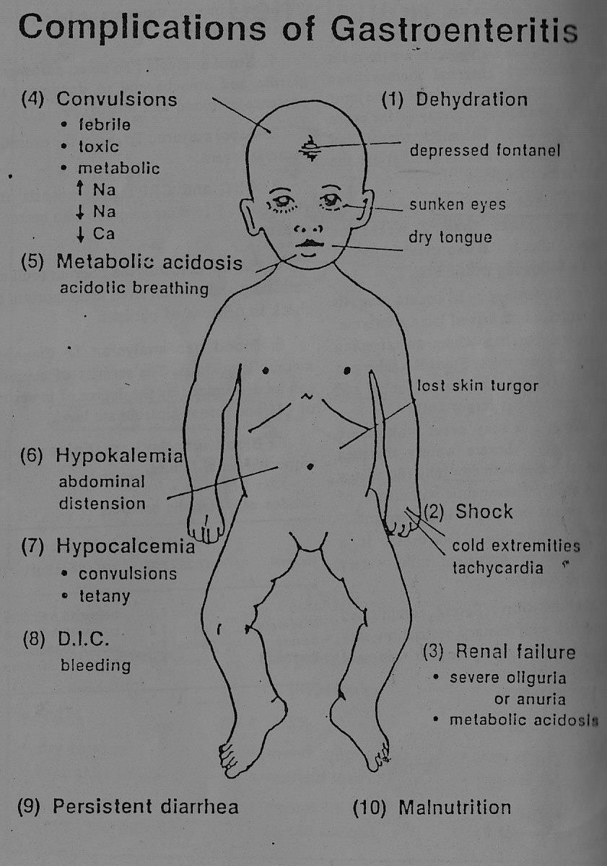

Slide 34
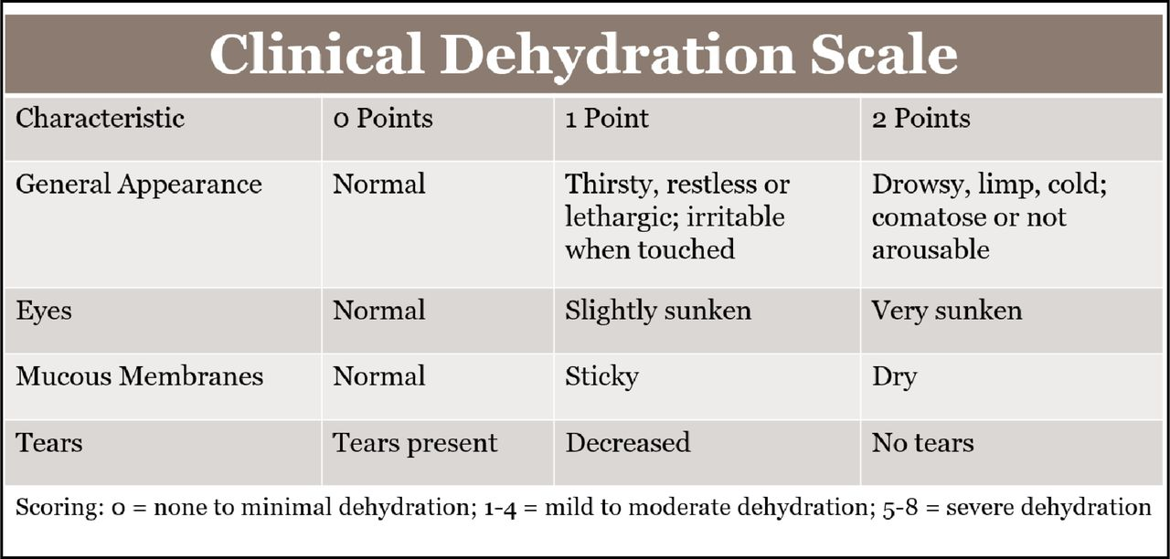

Slide 35
Treatment of Gastroenteritis
Fluids and rehydration solutions
Rarely antibiotics for certain infections
Rarely drugs to limit vomiting or diarrhea
Usually the only treatment needed for gastroenteritis is getting bed rest and drinking an adequate amount of fluids.
Once a child has gastroenteritis, parents should monitor their child’s hydration status.
Drugs that stop diarrhea or antibiotics might be given but only in certain specific situations under the guidance of a doctor.

Slide 36
Rehydration
Children should be encouraged to drink fluids even if just in small, frequent amounts.
Infants should continue to breastfeed or drink formula in addition to an oral electrolyte solution (oral rehydration solution —available as powders and liquids in pharmacies and some grocery stores).
Juice, soda, carbonated beverages, teas, sports drinks, and beverages containing caffeine should not be given to infants and young children. These drinks may contain too much sugar, which can worsen diarrhea, and contain too few salts (electrolytes), which are needed to replace those the body has lost.
For adolescents, sports drinks are preferable to juice and soda because of their lower sugar content, but they still have lower amounts of electrolytes than oral electrolyte solutions.
Plain water is not ideal for treating dehydration in children of any age because there are no salts in plain water.

Slide 37
Children who are vomiting should be given frequent small amounts of fluid to help prevent dehydration.
Parents should offer the child a few sips of a liquid.
If the liquid is not vomited, the sips are repeated every 10 or 15 minutes, increasing the amount given to an ounce or two after an hour or so and increased as tolerated.
These larger amounts can be given less often, about every hour. Liquids are absorbed very quickly, so if the child vomits more than 10 minutes after drinking, most of the liquid has been absorbed and the liquids should be continued.
The amount of liquid to give a child within a 24-hour period depends on the child’s age and weight but generally should be about 1½ to 2½ ounces of liquid for each pound the child weighs.
If the child’s vomiting or diarrhea lessens, parents may try feeding a more normal diet the next day.
Electrolyte solutions should not be continued alone for longer than 24 hours because of potential problems associated with inadequate nutritional intake.

Slide 38
Children who have diarrhea but little vomiting should get extra fluid to make up for the fluid lost in the diarrhea.
But, unlike children with vomiting, they may be given larger amounts of fluid at a time and they are fed their normal diet.
However, if the child has significant diarrhea, consumption of dairy products (which contain lactose) should probably be reduced. Severe gastroenteritis may decrease the child’s ability to absorb lactose, resulting in even more diarrhea.
Children who cannot keep down even sips of liquid or who have signs of severe dehydration (such as lethargy, dry mouth, lack of tears, and no urine for 6 hours or more) are in danger and should see a doctor immediately.
Children who do not have these signs should see a doctor if symptoms last more than 1 or 2 days. If the dehydration is severe, the doctor may give the child fluids by vein (intravenously).

Slide 39
Drugs
Antidiarrheal drugs such as loperamide are not usually recommended for children under 2 years of age unless they are prescribed by a doctor because there is little evidence they are beneficial and they may cause complications.
For children who have severe vomiting, doctors may give certain drugs that relieve vomiting (such as ondansetron) by mouth or intravenously.
Antibiotics are of no value when a viral infection is the cause of gastroenteritis.
Doctors give antibiotics only when gastroenteritis has been caused by specific bacteria (such as Shigella) that are known to respond to antibiotics.
Certain drugs (such as metronidazole and nitazoxanide) may be given for a parasitic infection.

Slide 40
Probiotics
Probiotics are organisms such as bacteria that are naturally found in the body and promote the growth of good bacteria.
Probiotics are also in foods and can be taken as supplements.
Probiotics, such as lactobacillus (typically present in yogurt), may slightly shorten the duration of diarrhea (perhaps by a day) if people begin taking them soon after the illness starts.
However, probiotics probably do not prevent more serious consequences of gastroenteritis, such as the need for intravenous fluids or for hospitalization

Slide 41
PREBIOTICS
Prebiotics are special plant fibers that help healthy bacteria grow in gut. This makes digestive system work better.
prebiotics in many fruits, vegetables, and whole grains
Benefits:
absorb calcium
Change the rate at which foods cause spikes in blood sugar
Ferment foods faster, so they spend less time in digestive system. That helps you not get constipated.
Keep the cells that line our gut healthy

Slide 42
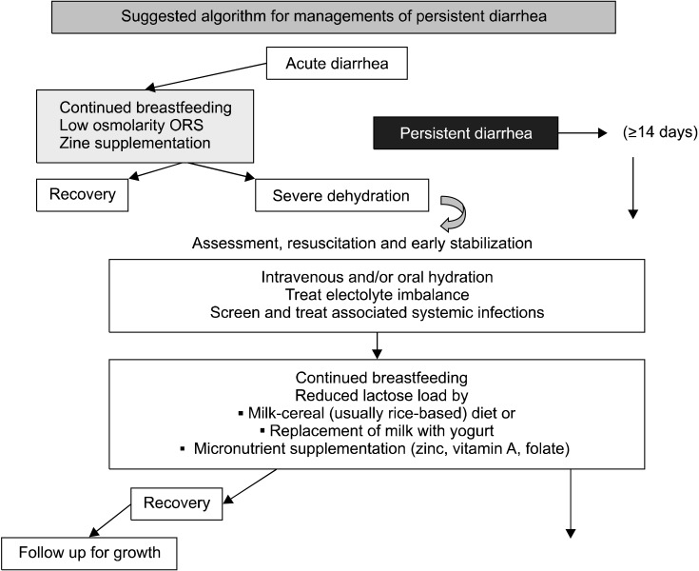

Slide 43
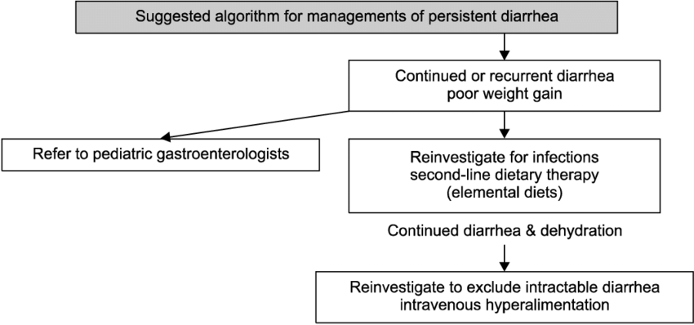

Slide 48
Thank you

